Slide 1

Angular JS

Slide 2



Prof. Nayan Mali
Department of Information Technology
A.D. Patel Institute of Technology
https://github.com/nayanmali
nayanrami@gmail.com
It.nayanmali@adit.ac.in
https://github.com/nayanrami

Slide 3



Slide 4


Slide 5


Slide 6


Slide 7
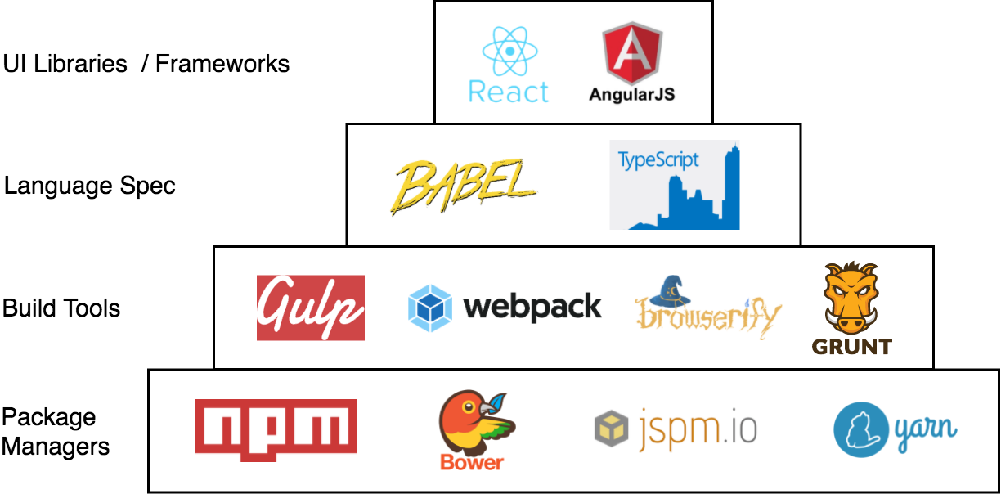

Slide 8
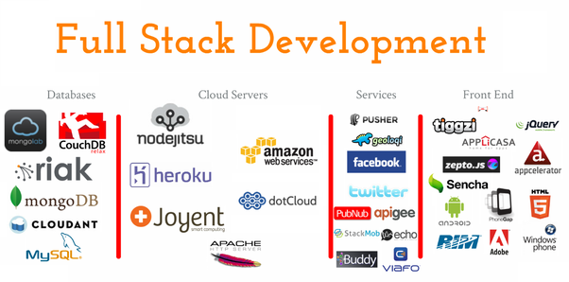

Slide 9
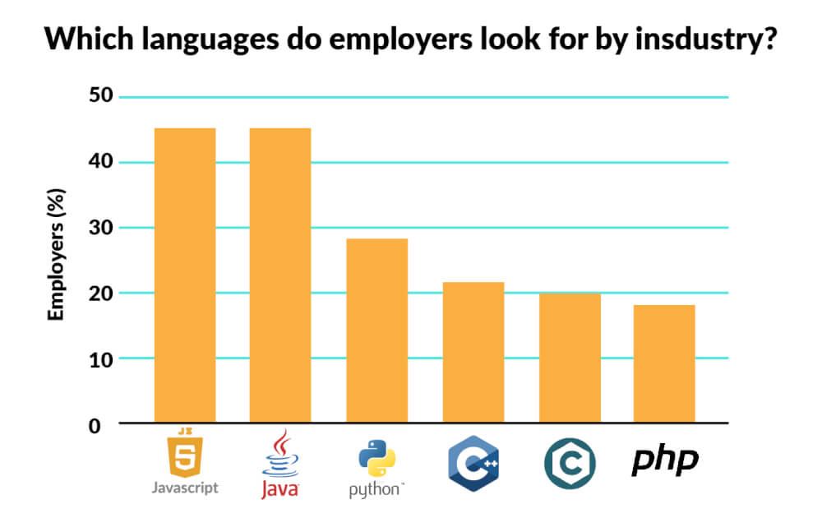

Slide 10
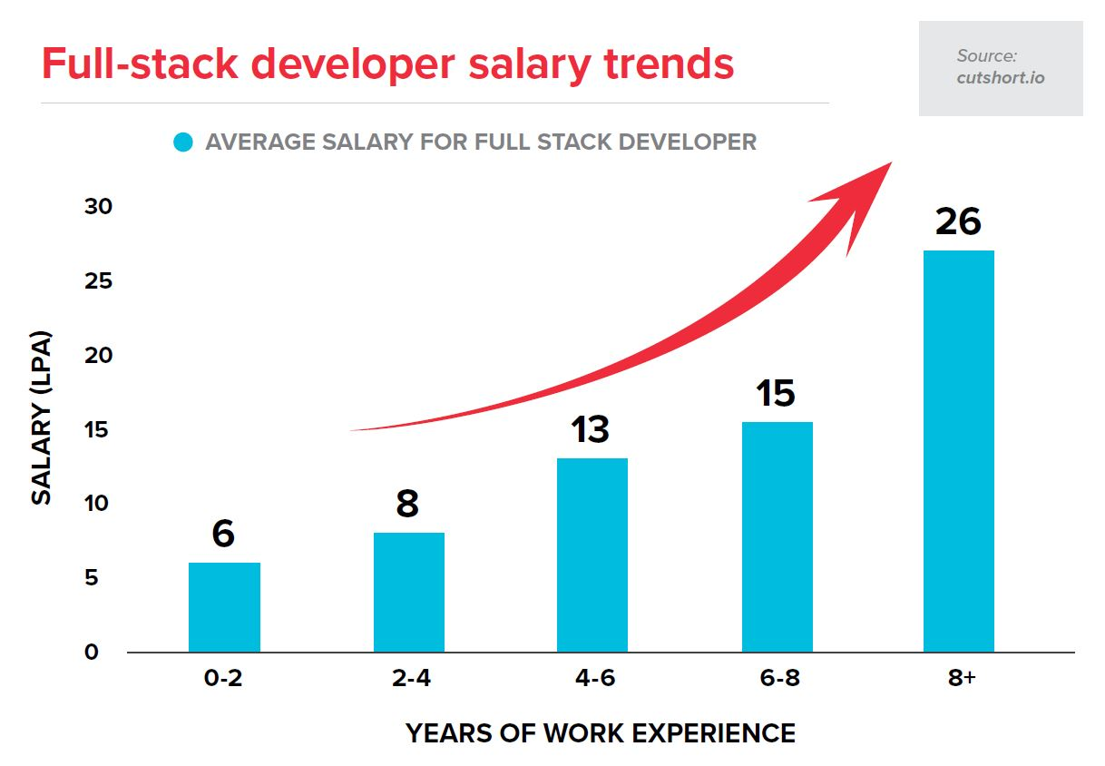

Slide 11
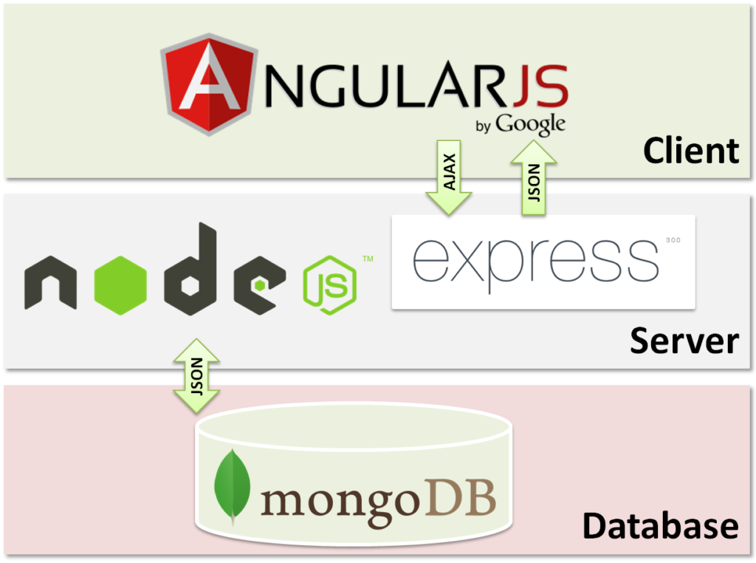
M - Mongodb
E - Express
A - AngularJs
N - NodeJs

Slide 12
What is

Slide 13

“Angular is a framework for building client applications in HTML,CSS and JavaScript/TypeScript.”
AngularJS was created by Google in 2010 as JavaScript framework

Slide 14
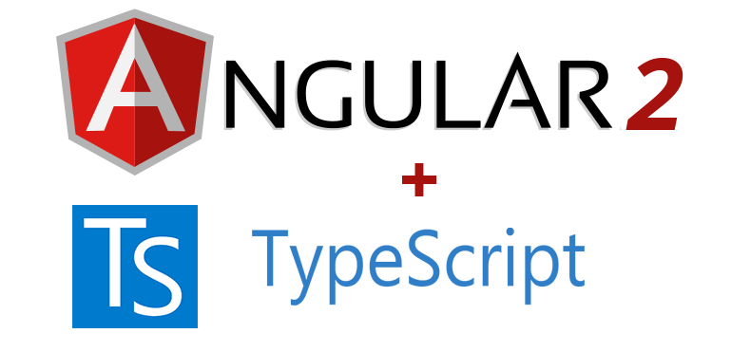
Angular 2
Angular team decided to rewrite it using TypeScript and that's how Angular 2 came into existence in 2016

Slide 15

Angular consist of different modules
angular/core 2.3.0
@angular/compiler 2.3.0
@angular/http 2.3.0
@angular/router 3.3.0

Slide 16
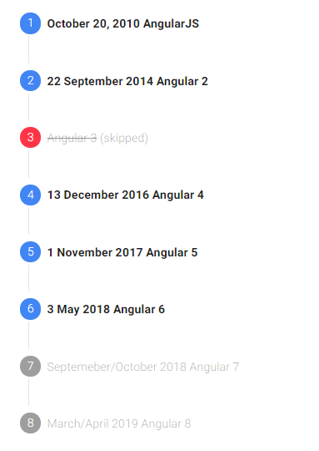
Angular Timeline

Slide 17
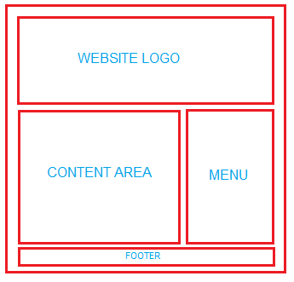

Component

